Slide 1

Application idea
Discover various places around the globe!
Share your opinion about places you visited
Get recommendations(based on your preferences, ratings of other users, nearby places they visited etc.)

Slide 2
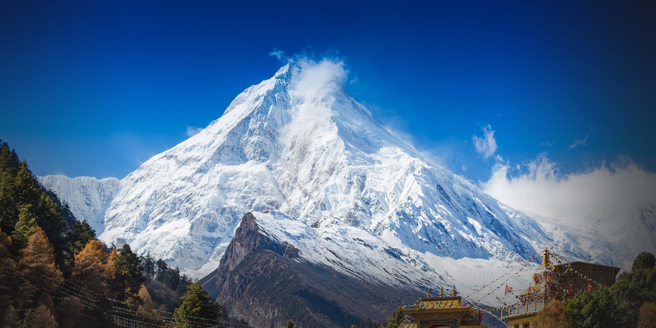
The Dataset
GeoNames - Over 11,000,000 entries from all around the world! link Each entry has:
ID
Name
Geographical Location (longitude and latitude)
Feature class, feature code
Feature class examples - A: “country, state, region,…”; H: “stream, lake,…”;
L: “parks, area,…”
Feature code examples - REST: “restaurant”; ZOO: “zoo”; RSRT: “resort”; PSN: “nuclear power station”.
Complete list at: http://www.geonames.org/export/codes.html
Country code and district
Population
Elevation
Timezone

Slide 3
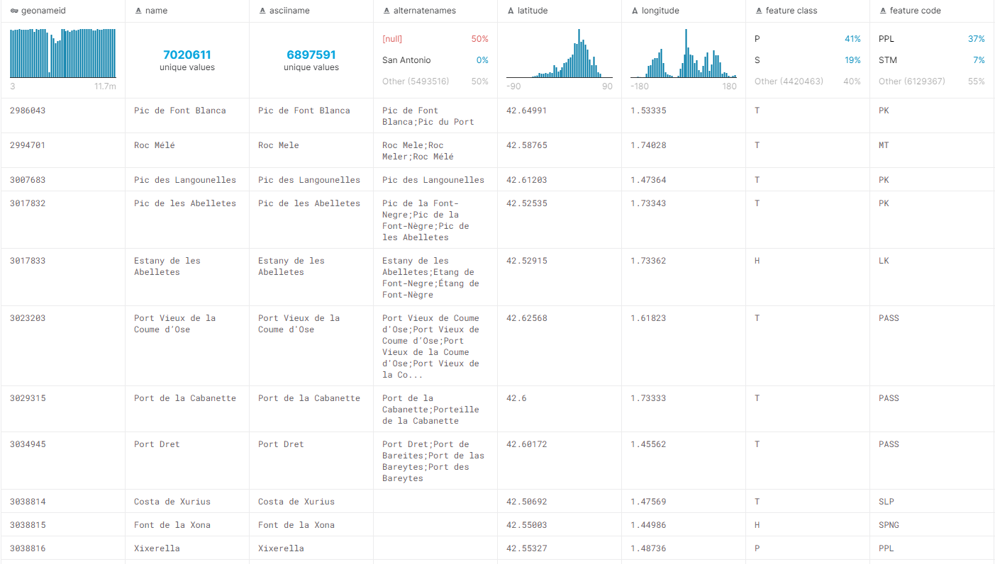

Slide 4
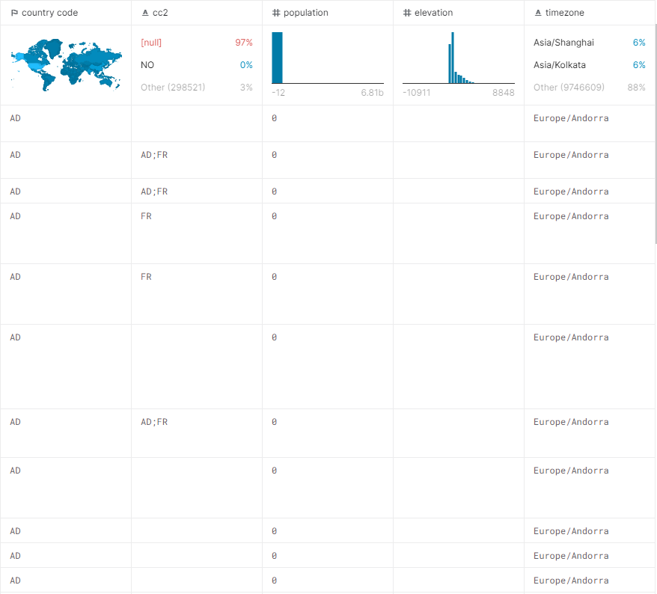

Slide 5
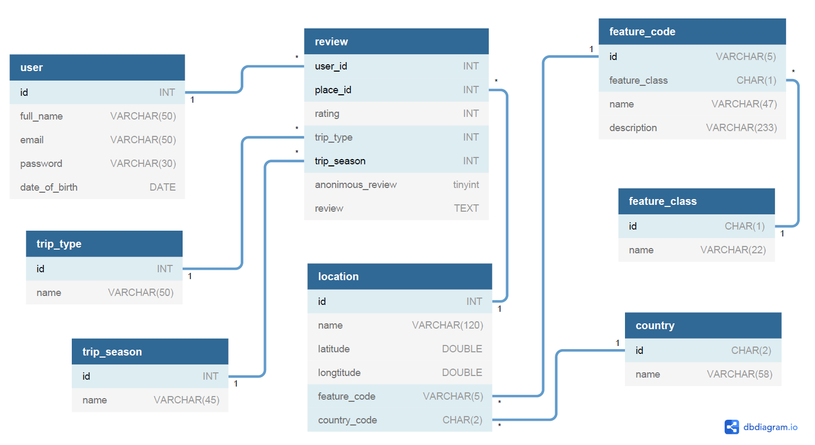
Schema

